Slide 1
Apprenticeships

Slide 2
Apprenticeship levels
Degree apprenticeships - equivalent to a bachelor's degree or masters
Higher apprenticeships - equivalent to NVQ level 4, HND or foundation degree
Standard apprenticeships - equivalent to a level 3 qualification (2 A level passes)
Foundation apprenticeships - equivalent to a level 2 qualifications (5 GCSE passes)

Slide 3
Case studies
Jane is a student studying A levels in her sixth form in Cardiff. She does maths, chemistry and physics, and is expected to achieve BBB. She would like an engineering career and has decided to achieve this through an apprenticeship.
Sam is studying for his GCSEs in Aberystwyth, and will achieve level 4+ in 5 of these, including maths and English. He has recently done some work experience in a care home and would like a career in social care. He doesn’t want to do A Levels, but is keen to enter the workplace.
Visit gov.wales/find-apprenticeship to support your research
Choose one apprenticeship your case study student could apply for
What level apprenticeship is it?
What are the entry requirements?
What qualification and experience will they gain?
How much will they earn?
How far from home is the apprenticeship?
What is the application deadline?

Slide 4
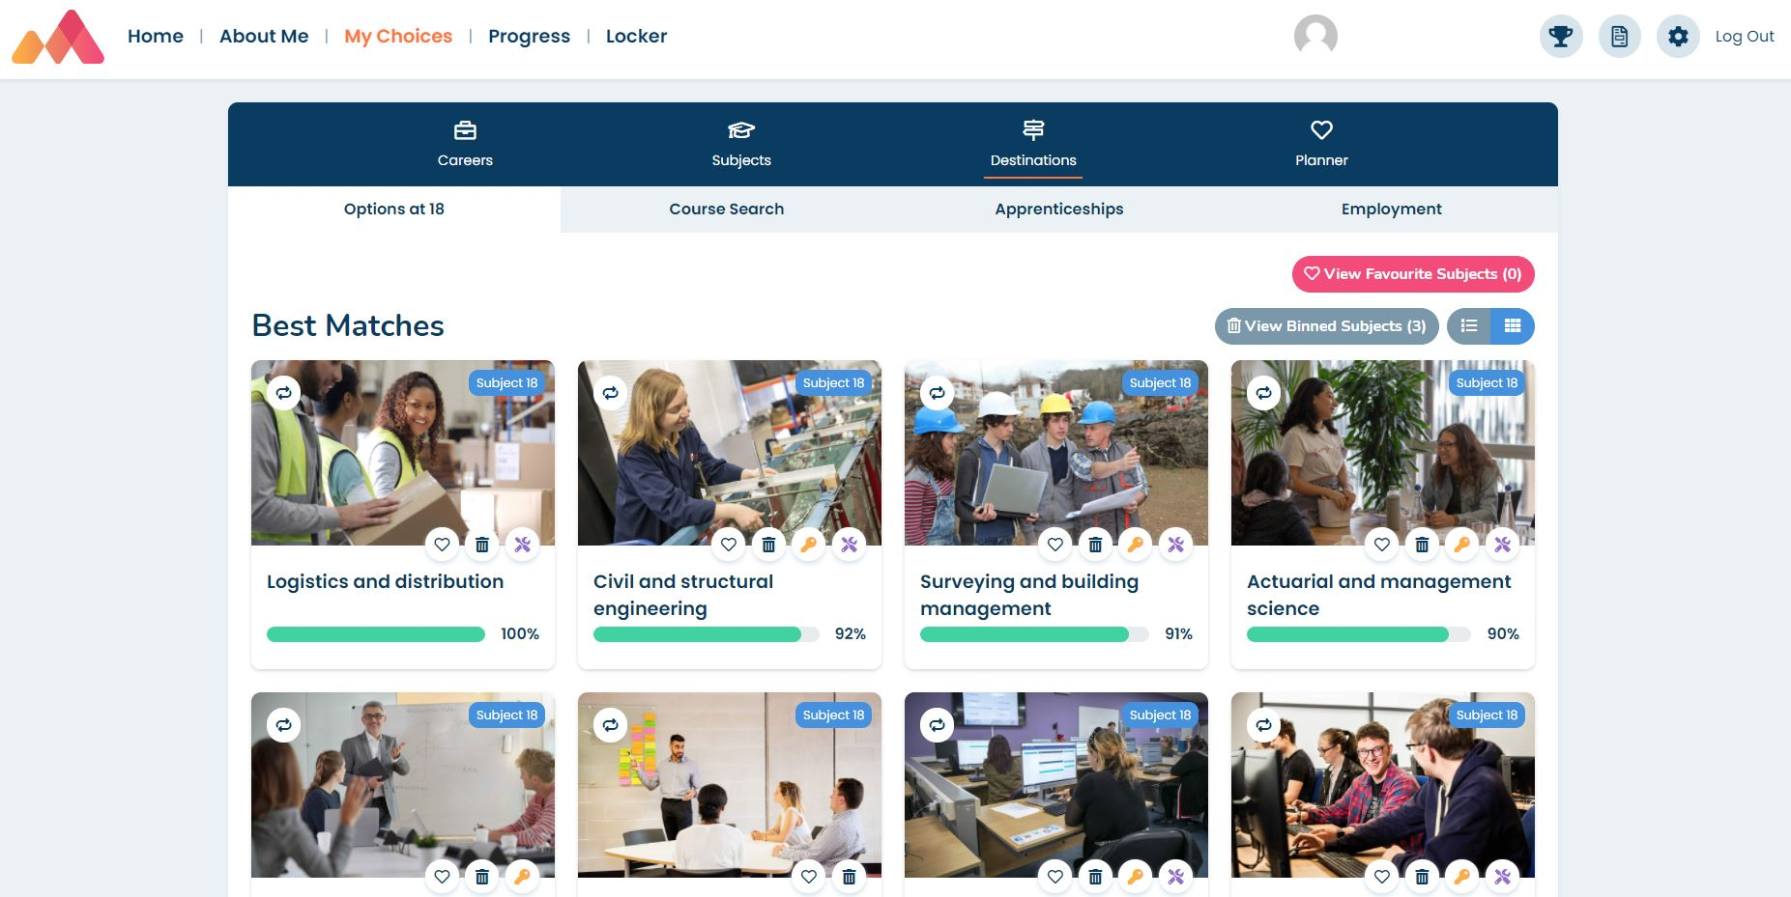
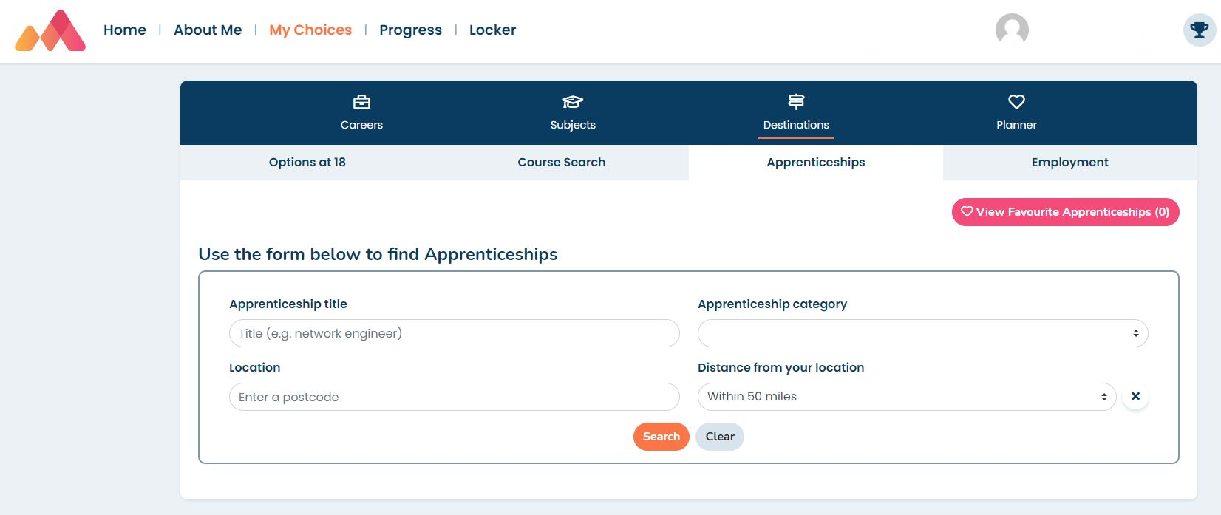
Apprenticeships on Morrisby
www.morrisby.com > Login
In your
My Choices > Destinations > Options at 18 area
In your My Choices > Destinations area
Click on a suggested subject tile to find out more about the apprenticeship

